Slide 1
Introduction to data mining
Week-1

Slide 2
Data Mining
Non-trivial extraction of implicit, previously unknown and potentially useful information from data.
The efficient discovery of previously unknown, valid, potentially useful, understandable patterns in large datasets
Exploration & analysis, by automatic or semi-automatic means, of large quantities of data in order to discover meaningful patterns.
Fayyad, U., Piatetsky-Shapiro, G., & Smyth, P. (1996)

Slide 3
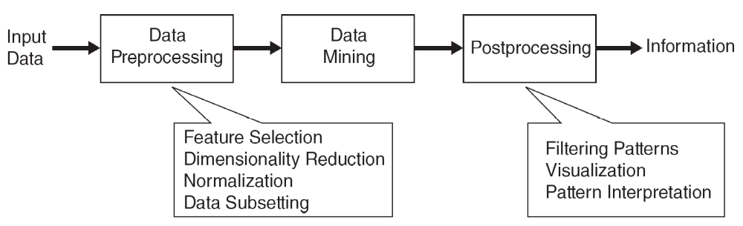
Data Mining

Slide 4
Data Mining
Prediction Methods
  Use some variables to predict unknown or future values of other variables.
Description Methods
  Find human-interpretable patterns that describe the data.
From [Fayyad, et.al.] Advances in Knowledge Discovery and Data Mining, 1996

Slide 5
What is Data Mining?
Process of discovering patterns and knowledge from large datasets
Combines machine learning, statistics, and database systems
Predictive: forecasting outcomes
Descriptive: discovering structure and relationships
Applications: fraud detection, marketing, healthcare

Slide 6
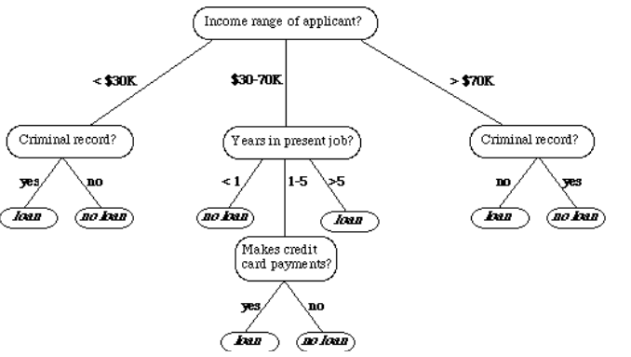
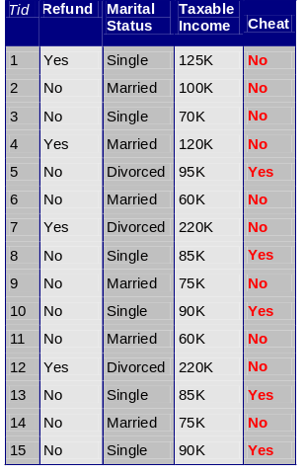
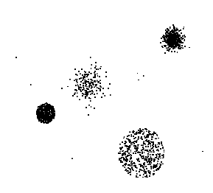


Data Mining Tasks …
Data
Clustering
Predictive Modeling
Association
Rules
Anomaly
Detection
Milk

Slide 7
Data
Collection of data objects and their attributes
An attribute is a property or characteristic of an object
  Examples: eye color of a person, temperature, etc.
  Attribute is also known as variable, field, characteristic, dimension, or feature
A collection of attributes describe an object
  Object is also known as record, point, case, sample, entity, or instance

Slide 8
Types of Attributes
There are different types of attributes
  Nominal
    Examples: ID numbers, eye color, zip codes
  Ordinal
    Examples: rankings (e.g., taste of potato chips on a scale from 1-10), grades, height {tall, medium, short}
  Interval
    Examples: calendar dates, temperatures in Celsius or Fahrenheit.
  Ratio
    Examples: temperature in Kelvin, length, counts, elapsed time (e.g., time to run a race)

Slide 9
Data Quality
Examples of data quality problems:
  Noise and outliers
  Wrong data
  Fake data
  Missing values
  Duplicate data

Slide 10
Data Quality
Noise refers to modification of original values
  Examples: distortion of a person’s voice when talking on a poor phone and “snow” on television screen
Outliers are data objects with characteristics that are considerably different than most of the other data objects in the data set
Reasons for missing values
  Information is not collected
  (e.g., people decline to give their age and weight)
  Attributes may not be applicable to all cases
  (e.g., annual income is not applicable to children)
Data set may include data objects that are duplicates, or almost duplicates of one another
  Major issue when merging data from heterogeneous sources

Slide 11
Classification Tasks
Classifying credit card transactions as legitimate or fraudulent
Classifying land covers (water bodies, urban areas, forests, etc.) using satellite data
Categorizing news stories as finance, weather, entertainment, sports, etc
Identifying intruders in the cyberspace
Predicting tumor cells as benign or malignant
Classifying secondary structures of protein as alpha-helix, beta-sheet, or random coil

Slide 12
Classification: Application
Fraud Detection
  Goal: Predict fraudulent cases in credit card transactions.
  Approach:
    Use credit card transactions and the information on its account-holder as attributes.
    Label past transactions as fraud or fair transactions. This forms the class attribute.
    Learn a model for the class of the transactions.
    Use this model to detect fraud by observing credit card transactions on an account.

Slide 13
Classification Techniques
Decision tree analysis
Statistical analysis
Neural networks
Support vector machines
Case-based reasoning
Bayesian classifiers
Genetic algorithms
Rough sets

Slide 14
Assessment Methods
Predictive accuracy
  Hit rate
Speed
  Model building; predicting
Robustness
Scalability
Interpretability
  Transparency, explainability

Slide 15
Assessment Methods
Accuracy
F1-score, ROC-AUC
Recall, Sensitivity
Precision + Recall

Slide 16
Regression
Predict a value of a given continuous valued variable based on the values of other variables, assuming a linear or nonlinear model of dependency.
Extensively studied in statistics, neural network fields.
Examples:
  Predicting sales amounts of new product based on advetising expenditure.
  Predicting wind velocities as a function of temperature, humidity, air pressure, etc.
  Time series prediction of stock market indices.

Slide 17
Clustering
Finding groups of objects such that the objects in a group will be similar (or related) to one another and different from (or unrelated to) the objects in other groups
Understanding
  Custom profiling for targeted marketing
  Group related documents for browsing
  Group genes and proteins that have similar functionality
  Group stocks with similar price fluctuations
Summarization
  Reduce the size of large data sets

Slide 18
Clustering: Application
Market Segmentation:
  Goal: subdivide a market into distinct subsets of customers where any subset may conceivably be selected as a market target to be reached with a distinct marketing mix.
  Approach:
    Collect different attributes of customers based on their geographical and lifestyle related information.
    Find clusters of similar customers.
    Measure the clustering quality by observing buying patterns of customers in same cluster vs. those from different clusters.

Slide 19
Association Rule
Given a set of records each of which contain some number of items from a given collection
  Produce dependency rules which will predict occurrence of an item based on occurrences of other items.
Market-basket analysis
  Rules are used for sales promotion, shelf management, and inventory management
Telecommunication alarm diagnosis
  Rules are used to find combination of alarms that occur together frequently in the same time period
Medical Informatics
  Rules are used to find combination of patient symptoms and test results associated with certain diseases

Slide 20
Why a Methodology?
Over 80% of data mining projects fail without structure
CRISP-DM improves success rates by ~75%
Supports iterative refinement rather than linear execution

Slide 21
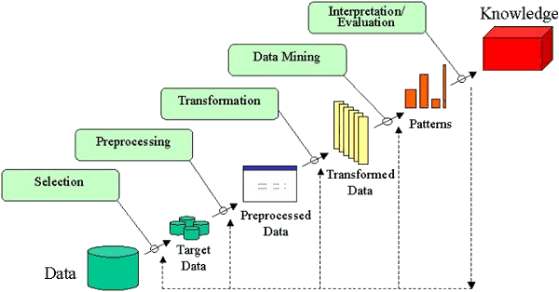
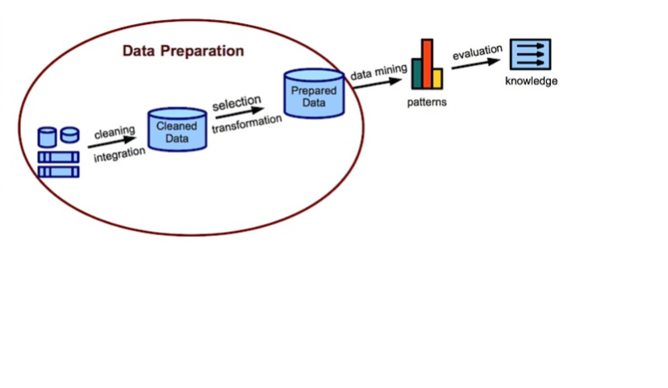
KDD

Slide 22
Components of KDD
Data Selection
Data Cleaning
Data Integration
Data Transformation
Data Mining
Pattern Evaluation
Knowledge Presentation

Slide 23
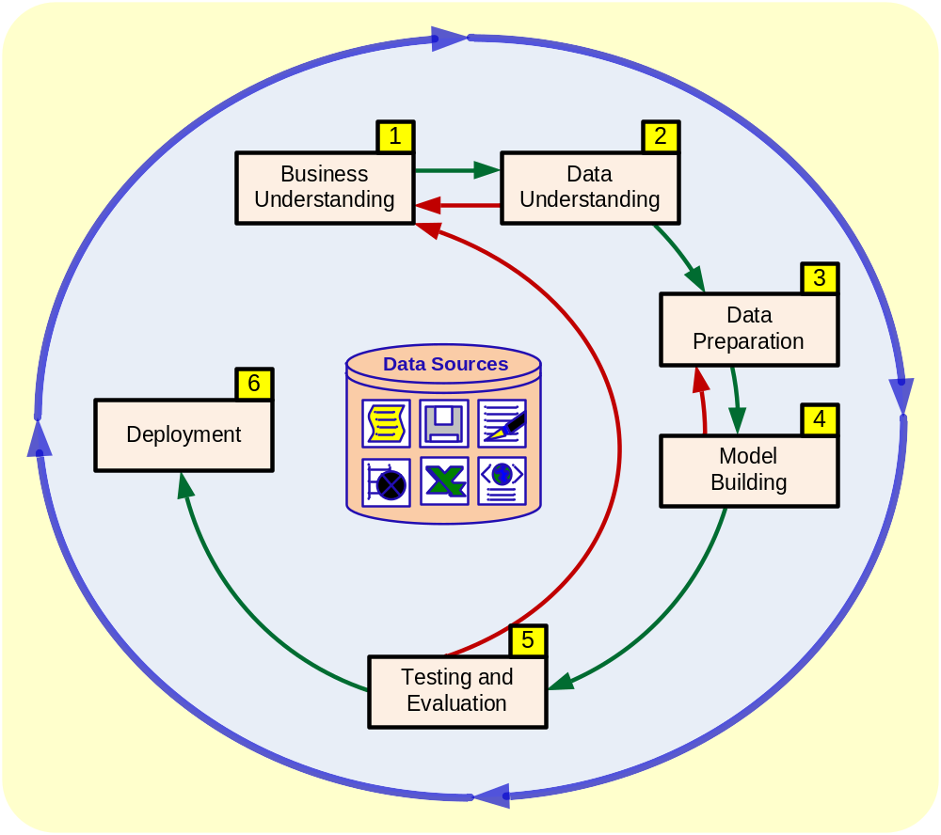
CRISP-DM
Pearson Education

Slide 24
CRISP-DM Framework
Business Understanding
Data Understanding
Data Preparation
Modeling
Evaluation
Deployment
Strong feedback loops between phases

Slide 25
Iterative Nature of CRISP-DM
Phases are revisited as insights evolve
Modeling failures often require new data preparation
Data preparation consumes 60–80% of project time

Slide 26
Phase 1: Business Understanding – Tasks
Determine business objectives
Assess situation and constraints
Translate objectives into data mining goals
Produce a project plan

Slide 27
Business Objectives Example
Business goal: Reduce customer churn by 15%
Data mining goal: Predict churn probability > 0.7
Success metric: ROC-AUC > 0.85

Slide 28
Situation Assessment
Available data volume and quality
Tools: Python, R, SQL
Expertise, time, cost, and risk constraints

Slide 29
Step 1: Business Understanding
Step 2: Data Understanding
Step 3: Data Preparation (!)
Step 4: Model Building
Step 5: Testing and Evaluation
Step 6: Deployment

Slide 30
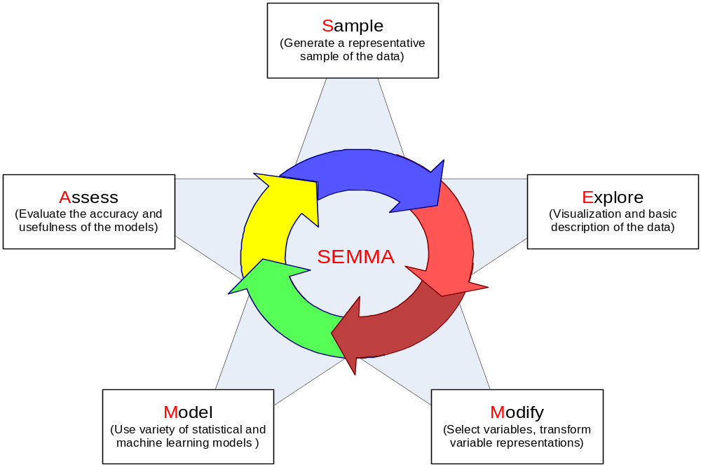
SEMMA
Pearson Education

Slide 31
Outputs of Phase 1
Formal project plan and timeline
Defined success criteria
Shared terminology and assumptions

Slide 32
Phase 2: Data Collection
Data sources: databases, CSV files, APIs
Initial dataset example: 1M records, 50 attributes

Slide 33
Describe the Data
Attribute types: numeric, categorical, text
Record counts and distributions
Missing data percentages (e.g., income 20% missing)

Slide 34
Explore the Data
Visualisation: histograms, boxplots, correlation heatmaps
Basic aggregations and subsets
Early hypothesis generation

Slide 35
Verify Data Quality
Detect missing values and outliers
Check for duplicates and inconsistencies
Produce a data quality report

Slide 36
Phase 3: Select Data
Choose relevant attributes and records
Balance relevance, quality, and size
Exclude unnecessary variables

Slide 37
Clean Data
Handle missing values (mean/median/mode)
Noise reduction using binning
Outlier detection using Z-score or IQR

Slide 38
Construct Data
Create derived attributes (e.g., Age = 2025 − DOB)
Aggregate transactional data into summaries

Slide 39
Integrate Data
Merge multiple tables using joins
Resolve schema conflicts
Remove duplicate records

Slide 40
Format Data
Normalization using min–max scaling
Discretization into categorical bins
Prepare data for modeling algorithms

Slide 41
Data Preparation Reality
Consumes 60–80% of total effort
Often repeated multiple times
Critical to model performance

Slide 42
Phase 4: Select Modeling Techniques
Supervised learning: classification, regression
Unsupervised learning: clustering, association
Technique selection depends on goals and data

Slide 43
Test Design
Split data: 70% train, 15% validation, 15% test
K-fold cross-validation (k=5 or 10)
Hyperparameter tuning via grid search

Slide 44
Build Models
Example: Logistic regression for churn prediction
Implementation using scikit-learn
Train models on prepared datasets

Slide 45
Assess Models
Metrics: accuracy, precision, recall, F1-score
ROC and AUC for classification
Compare multiple models objectively

Slide 46
Phase 5: Evaluation
Assess alignment with business objectives
Validate discovered patterns
Decide whether to proceed or iterate

Slide 47
Phase 6: Deployment
Deploy models via APIs or batch processes
Monitor performance and data drift
Plan maintenance and updates

Slide 48
Technique Comparison
Classification: interpretable but may overfit
Clustering: automatic grouping, sensitive to initialization
Regression: fast but assumes linearity
Association rules: intuitive but scalability issues

Slide 49
References
Introduction to Data Mining, 2nd Edition Tan, Steinbach, Karpatne, Kumar
Fayyad, U., Piatetsky-Shapiro, G., & Smyth, P. (1996)
Chapman et al. (2000); Han et al. (2012); Witten et al. (2016)

Slide 50
Ethical Implications of Machine Learning
Risks, Challenges, and Responsible AI Practices

Slide 51
Introduction
Machine Learning (ML) systems influence decisions in healthcare, finance, hiring, and governance.
Ethical implications arise when ML affects human rights, fairness, and accountability.

Slide 52
Bias and Discrimination
• ML models learn from historical data
• Biased data leads to unfair outcomes
• Can reinforce social inequalities
Example: Hiring or credit scoring bias

Slide 53
Privacy Concerns
• Large-scale personal data collection
• Risk of surveillance and data misuse
• Re-identification of anonymized data
Example: Tracking user behavior without consent

Slide 54
Lack of Transparency (Black Box Models)
• Complex ML models are hard to explain
• Users cannot understand decisions
• Difficult to challenge unfair outcomes
Example: Loan rejection without explanation

Slide 55
Accountability and Responsibility
• Unclear responsibility for ML decisions
• Developers, organizations, or algorithms?
• Legal and ethical challenges
Example: Autonomous vehicle accidents

Slide 56
Informed Consent & Data Misuse
• Data often collected without clear consent
• Secondary use of data without permission
Ethical violation of user trust
Example: Social media data used for profiling

Slide 57
Security Risks & Misuse
• Adversarial attacks on ML models
• Data poisoning and model manipulation
• Deepfakes and misinformation
Example: AI-generated fake media

Slide 58
Job Displacement & Economic Impact
• Automation replaces human labor
• Risk of unemployment in some sectors
• Need for reskilling and social policies
Example: AI replacing customer support roles

Slide 59
Human Autonomy & Over-Reliance
• Excessive trust in ML decisions
• Reduced human judgment
• Ethical need for human oversight
Example: AI-assisted medical diagnosis

Slide 60
Environmental Impact of ML
• High energy consumption
• Carbon footprint of large models
• Sustainability concerns
Example: Large data centers powering AI

Slide 61
Ethical Principles for Responsible ML
• Fairness and non-discrimination
• Transparency and explainability
• Privacy protection
• Accountability
• Human-in-the-loop systems

Slide 62
Conclusion
Ethical ML ensures trust, fairness, and social benefit.
Responsible design and regulation are essential for sustainable AI.

Slide 63
Exercise : Social Media Mental Health Prediction
The company wants to sell insights about users’ mental health to insurance companies.
Decision options:
  Sell the data as-is.
  Anonymize the data before selling.
  Ask users for consent before selling.
  Refuse to sell the data.
Immediate feedback:
  Option 1 → Legal and ethical risk, potential backlash, profit increase
  Option 2 → Lower risk, some ethical concerns remain, profit moderate
  Option 3 → Ethical and legal safe, slower business outcome
  Option 4 → Fully ethical, business opportunity lost

Slide 64
References
Floridi et al. (2018), AI4People Ethical Framework
GDPR – General Data Protection Regulation
OECD Principles on AI (2019)
ACM Code of Ethics
IEEE Ethically Aligned Design

